Slide 1
Fundamentals of Programming
Selections

Slide 2
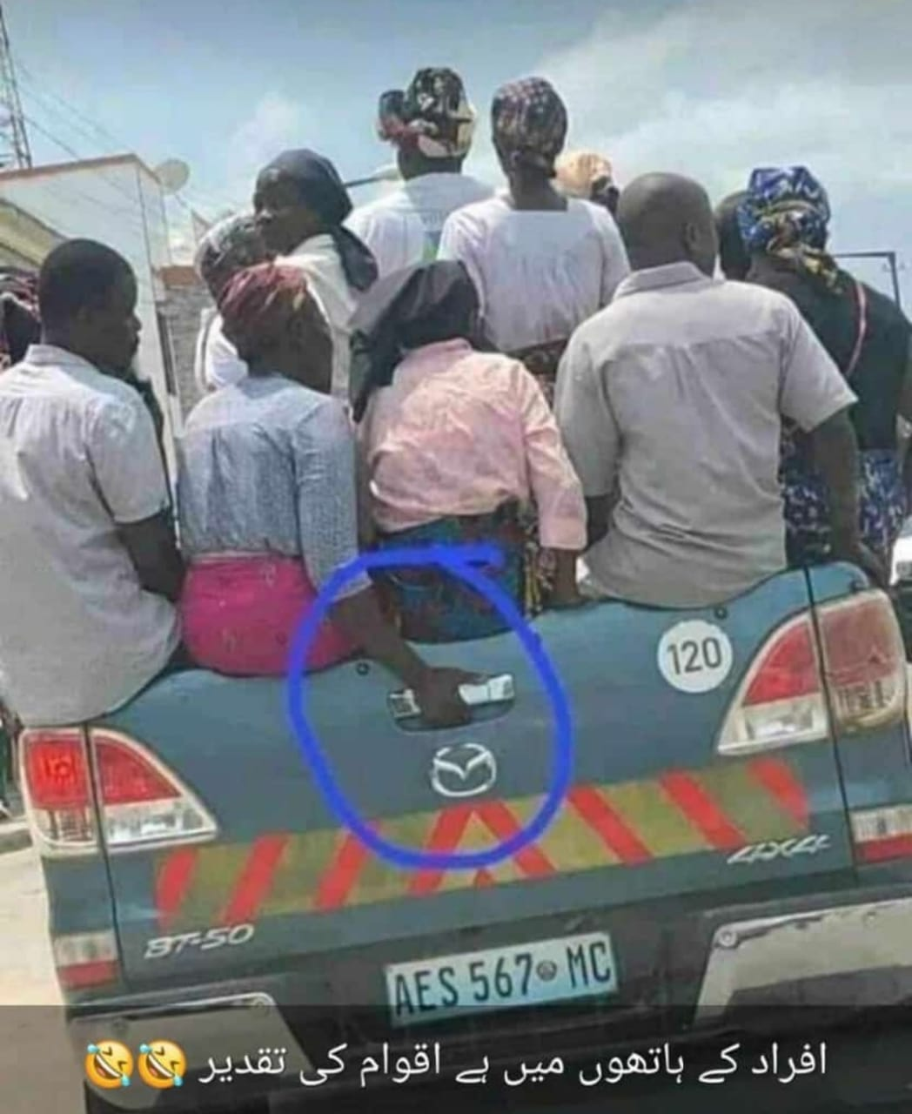

Slide 3


Slide 4
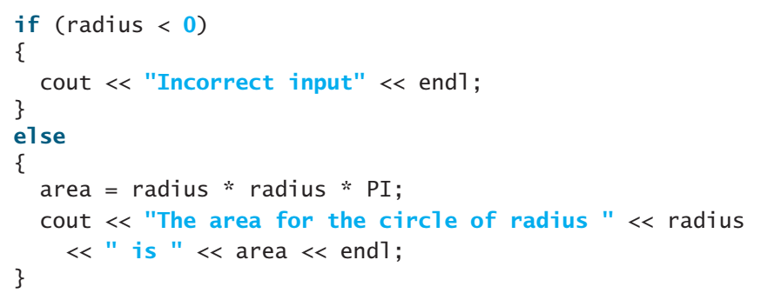
Introduction
The program can decide which statements to execute based on a condition
Selection statements use conditions that are Boolean expressions. A Boolean expression is an expression that evaluates to a Boolean value: true or false.

Slide 5
The bool Data Type
The bool data type declares a variable with the value either true or false
Comparison of two values/ variables is either True or False
C++ provides six relational operators for comparisons
Operator | Description | Example (double radius = 5;) | Result
< | Less than | radius < 0 | False
<= | Less than or equal | radius <= 0 | False
> | Greater than | radius > 0 | True
>= | Greater than or equal | radius >= 0 | True
== | Equal to | radius == 0 | False
!= | Not equal to | radius != 0 | True

Slide 6

The bool Data Type
variable that holds Boolean value is called Boolean variable.
The bool data type is used to declare Boolean variables.
For example, the following statement assigns true to the variable lightsOn
true and false are Boolean literals, just like a number such as 10. They are keywords and cannot be used as identifiers in your program
Internally, C++ uses 1 to represent true and 0 for false. If you display a bool value to the console, 1 is displayed if the value is true and 0 if it is false.

Slide 7
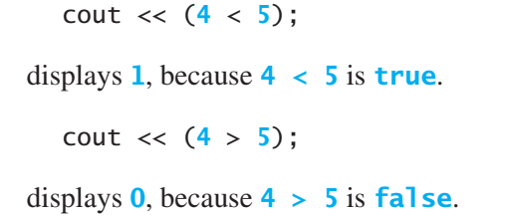
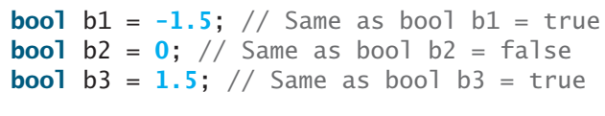
The bool Data Type
In C++, you can assign a numeric value to a bool variable. Any nonzero value evaluates to true and zero value evaluates to false. For example, after the following assignment statements, b1 and b3 become true, and b2 becomes false

Slide 8
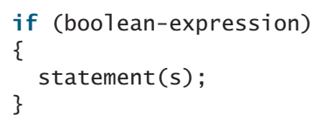
if Statements
An if statement is a construct that enables a program to specify alternative path of execution.
An if statement executes statements if the boolean-expression evaluates to true.

Slide 9
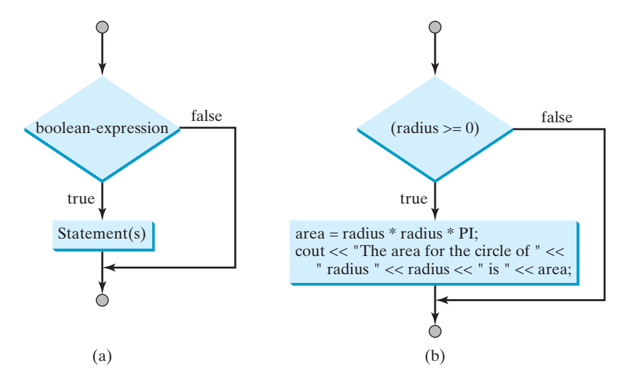
if Statements
The flowchart illustrates how C++ executes the syntax of an if statement. A flowchart is a diagram that describes an algorithm or process, showing the steps as boxes of various kinds, and their order by connecting these with arrows. Process operations are represented in these boxes, and arrows connecting them represent flow of control.
A diamond box is used to denote a Boolean condition and a rectangle box is used to represent statements.

Slide 10
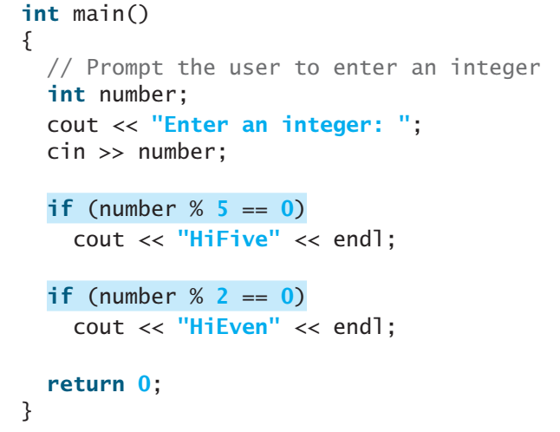
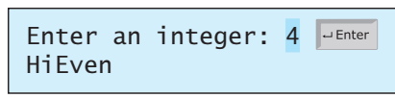
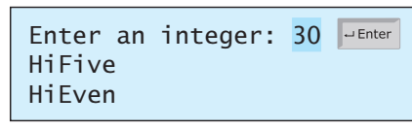
if Statements
The number is divisible by 5 or 2

Slide 11
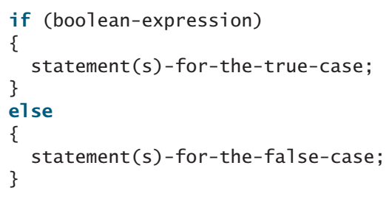
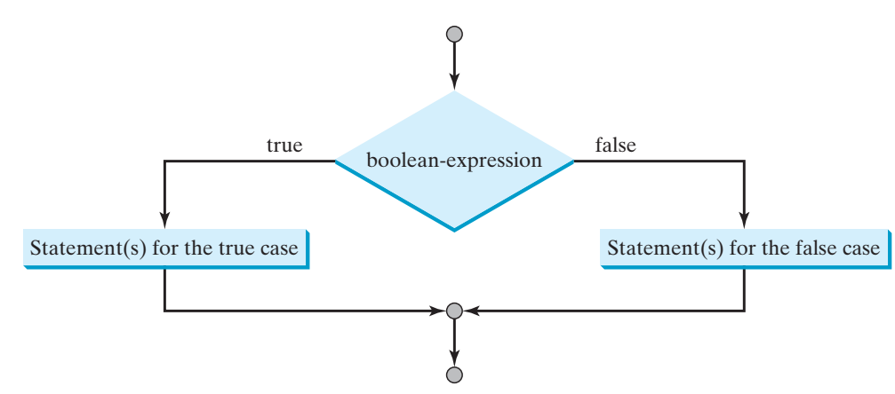
if-else Statements
An if-else statement decides which statements to execute based on whether the condition is true or false.

Slide 12
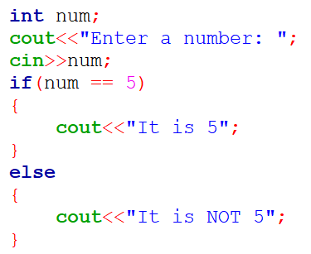
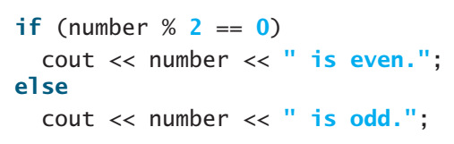
if-else Statements

Slide 13
Nested if-else Statements
An if-else block can contain multiple if-else blocks in it
A number is greater, lesser or equal to 5?
Greater | Lesser | Equal
> | < | ==
if
else
if
else

Slide 14
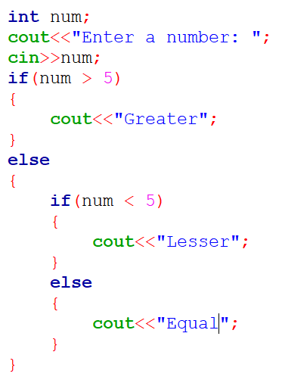
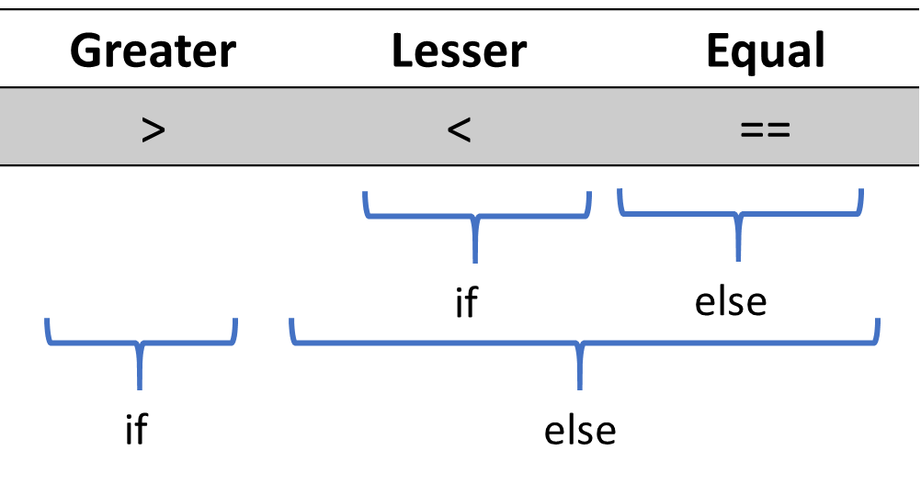
Nested if-else Statements
A number is greater, lesser or equal to 5?

Slide 15
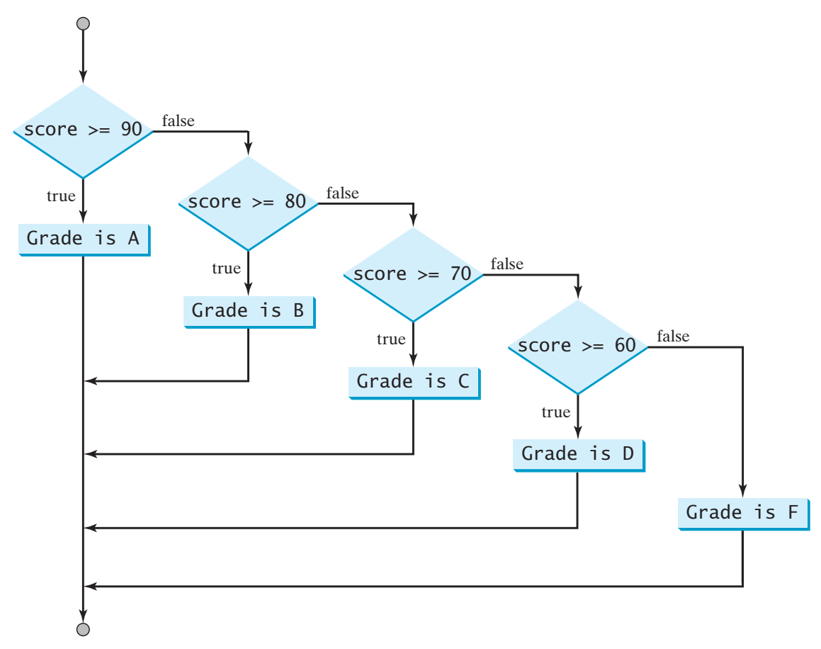
Nested if-else Statements

Slide 16
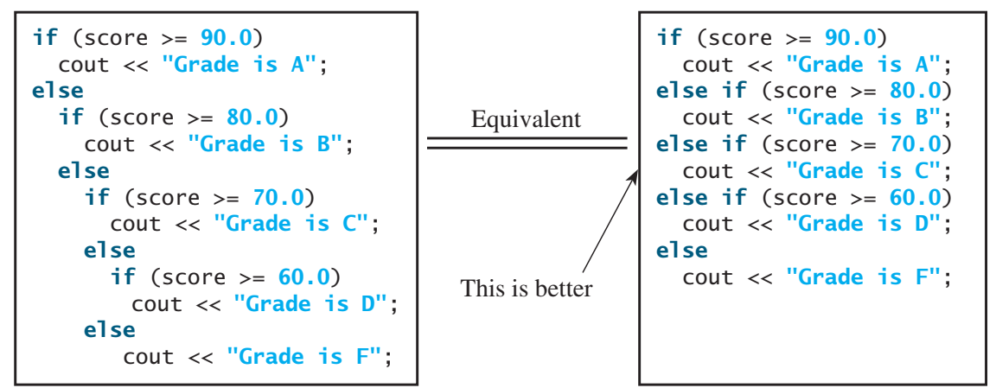
Nested if-else Statements

Slide 17
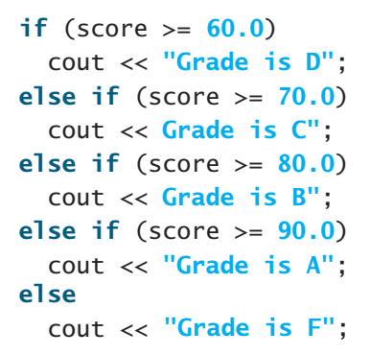
Nested if-else Statements
What is wrong with the following code?

Slide 18
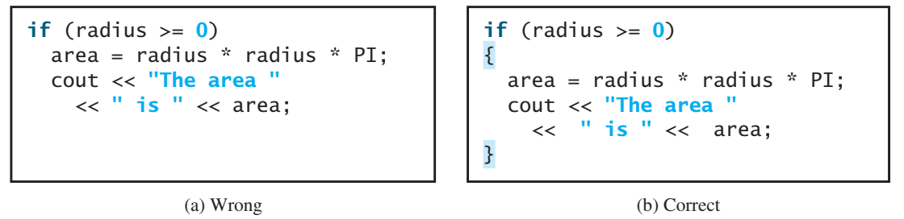
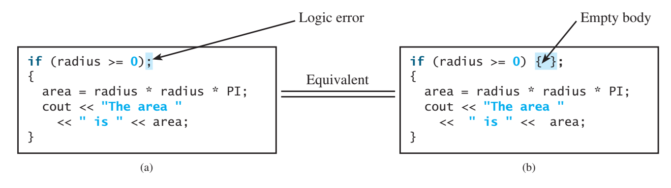
Common Errors and Pitfalls
Forgetting Necessary Braces
Wrong Semicolon at the if Line

Slide 19
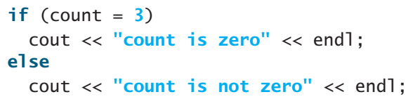
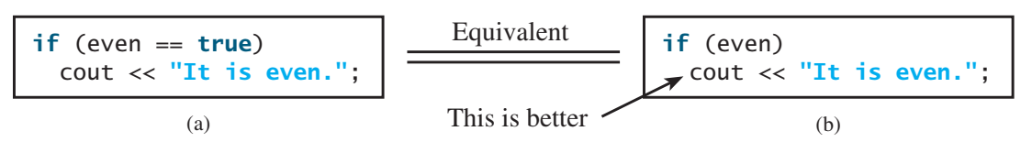
Common Errors and Pitfalls
Mistakenly Using = for ==
Redundant Testing of Boolean Values

Slide 20
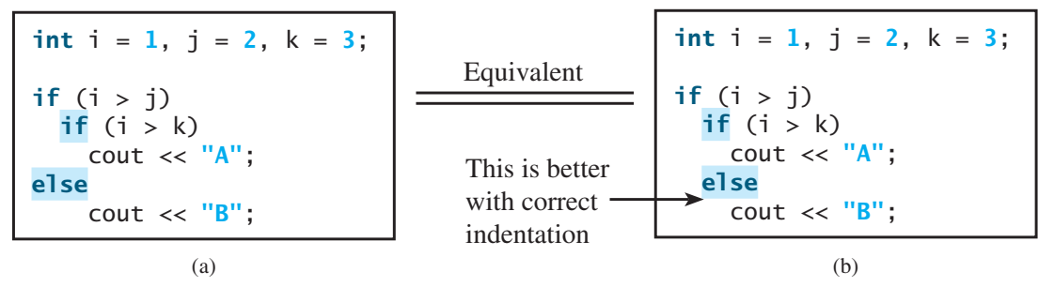
Common Errors and Pitfalls
Dangling else Ambiguity: always use parenthesis to correctly enclose relevant piece of code and if-else logic

Slide 21
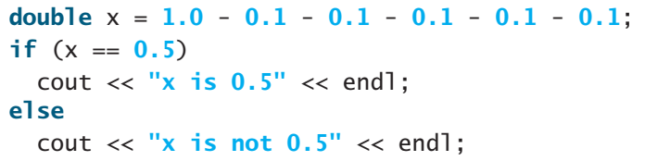
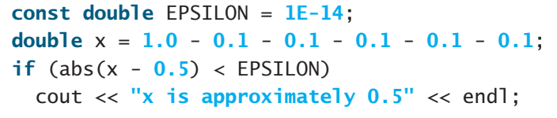
Common Errors and Pitfalls
Equality Test of Two Floating-Point Values

Slide 22
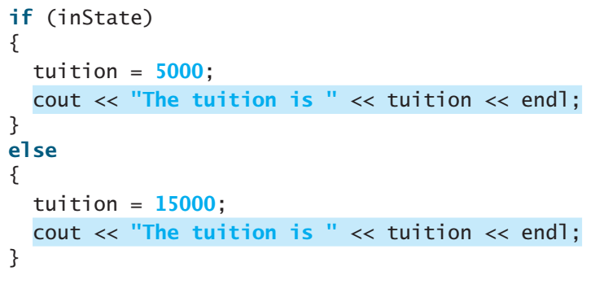
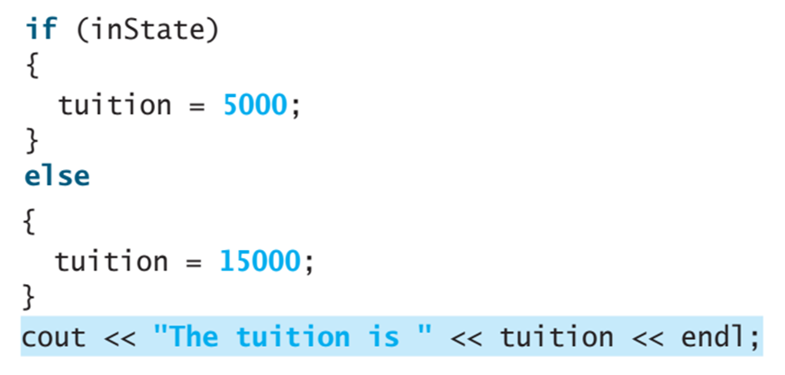
Common Errors and Pitfalls
Avoiding Duplicate Code in Different Cases

Slide 23
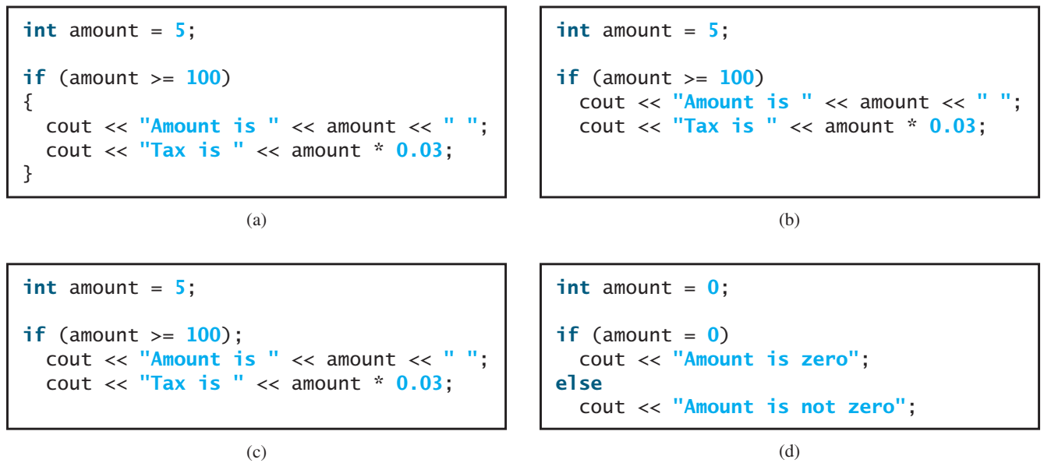
Code Output?

Slide 24
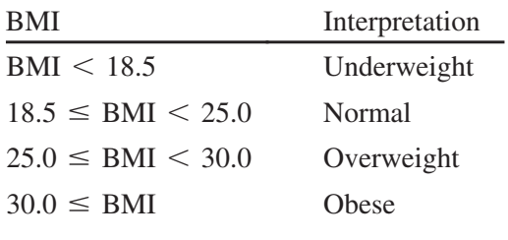
3.7 Case Study: Computing Body Mass Index
Body Mass Index (BMI) is a measure of health based on height and weight. You can calculate your BMI by taking your weight in kilograms and dividing it by the square of your height in meters. The interpretation of BMI for people 20 years or older is as follows:
< 18.5 | < 25 | < 30 | > 30

Slide 25
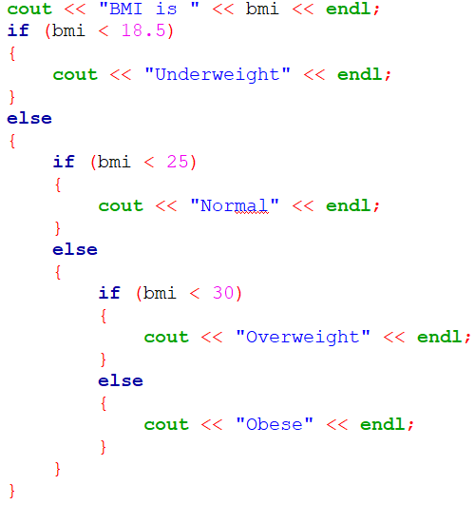
3.7 Case Study: Computing Body Mass Index

Slide 26
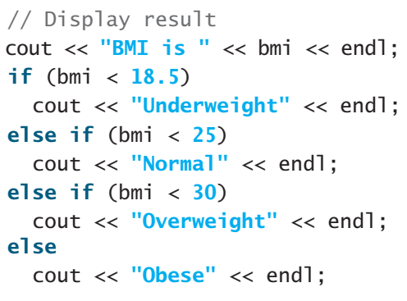
3.7 Case Study: Computing Body Mass Index
< 18.5 | > =
If | else
 | < 25 | > =
 | If | else
 |  | < 30 | >=
 |  | If | else

Slide 27
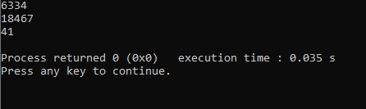
Generating Random Numbers
rand() function from cstdlib header file returns random integers
srand(seed) function from cstdlib header file returns random integers based on the seed
A good source for seed is current system time i.e time(0)

Slide 28
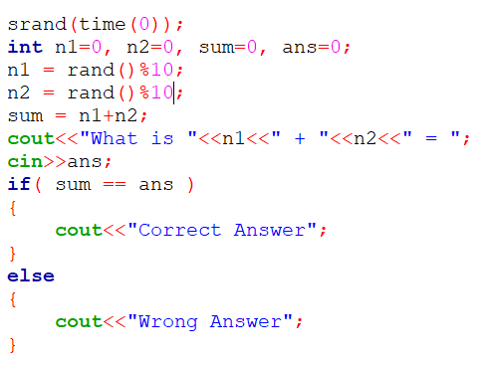
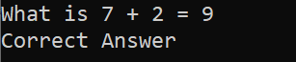
Generating Random Numbers
Write a program that asks simple addition question

Slide 29
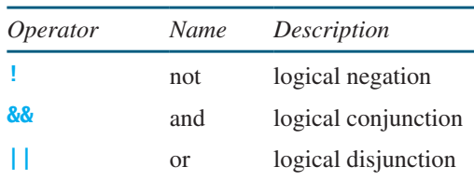
Logical Operators
The logical operators !, &&, and || can be used to create a compound Boolean expression.
The not (!) operator negates true to false and false to true
The and (&&) of two Boolean operands is true if and only if both operands are true.
The or (||) of two Boolean operands is true if at least one of the operands is true.

Slide 30
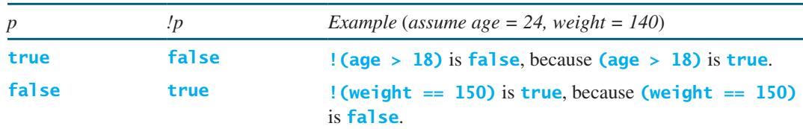
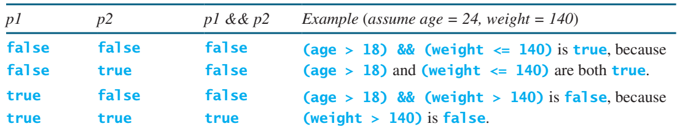
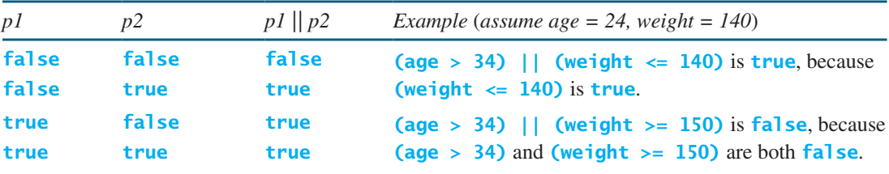
Logical Operators

Slide 31
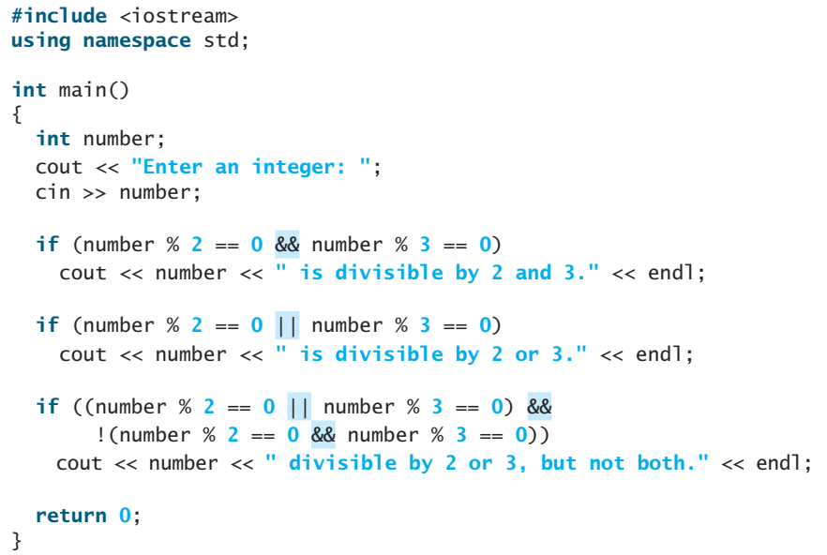
Logical Operators

Slide 32
3.11 Case Study: Determining Leap Year
A year is a leap year if it is divisible by 4 but not by 100, or if it is divisible by 400
Write expression for it

Slide 33
3.12 Case Study: Lottery
Suppose you are to develop a program to play the lottery. The program randomly generates a lottery of a two-digit number, prompts the user to enter a two-digit number, and determines whether the user wins according to the following rule:
1. If the user input matches the lottery number in the exact order, the award is $10,000.
2. If all the digits in the user input match all the digits in the lottery number, the award is $3,000.
3. If one digit in the user input matches a digit in the lottery number, the award is $1,000.

Slide 34
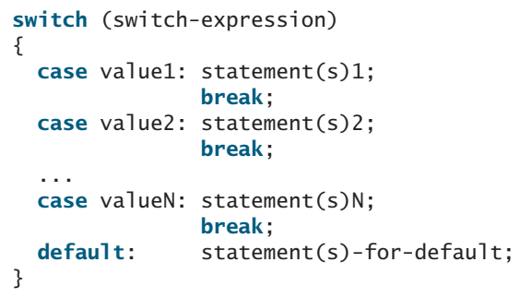
switch Statements
A switch statement executes statements based on the value of a variable or an expression.

Slide 35
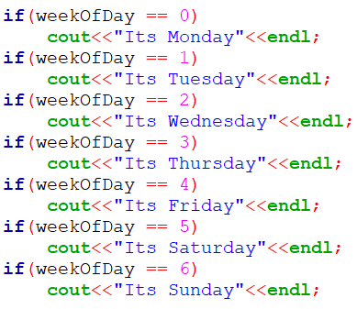
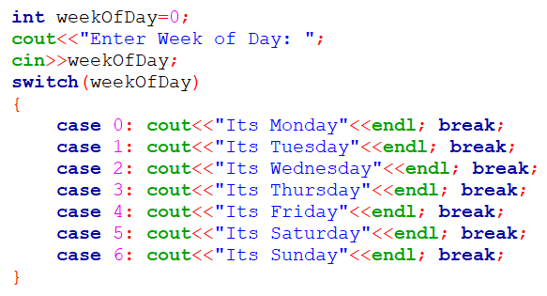

switch Statements

Slide 36
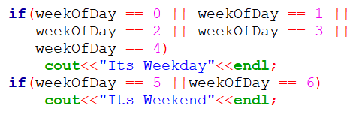


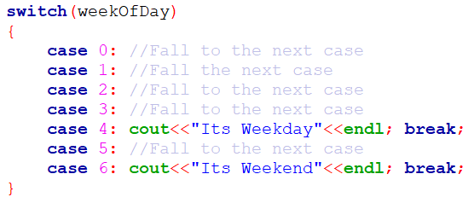
switch Statements

Slide 37
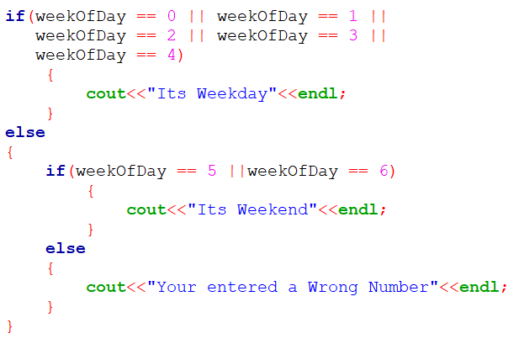

switch Statements

Slide 38
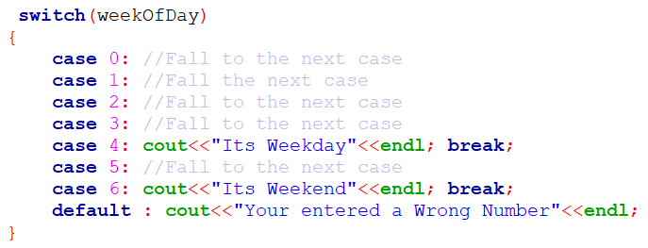
switch Statements

Slide 39
switch Statements
The switch-expression must yield an integral value and always be enclosed in parentheses.
The value1, ..., and valueN are integral constant expressions, meaning that they cannot contain variables, such as 1 + x. These values are integers and cannot be floating-point values.
When the value in a case statement matches the value of the switch-expression, the statements starting from this case are executed until either a break statement or the end of the switch statement is reached.
The default case, which is optional, can be used to perform actions when none of the specified cases matches the switch-expression.
The keyword break is optional. The break statement immediately ends the switch statement.

Slide 40
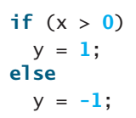

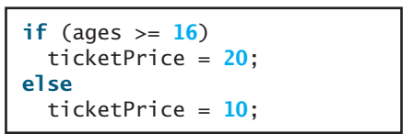
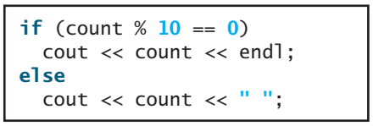
Conditional Expressions
A conditional expression evaluates an expression based on a condition
Rewrite the following if statements using the conditional operator:

Slide 41
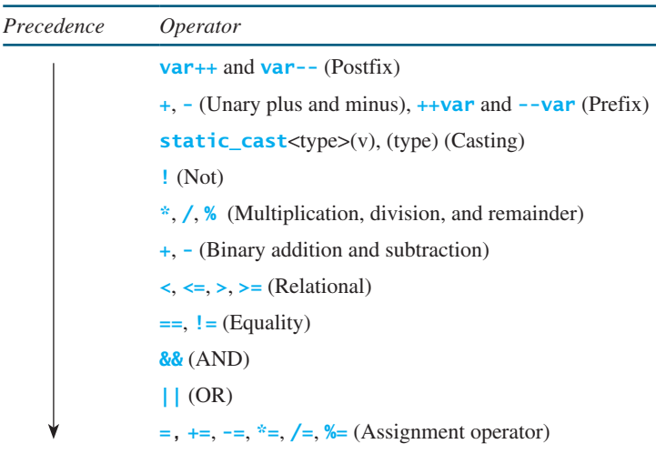
Operator Precedence and Associativity
Operator precedence and associativity determine the order in which operators are evaluated.

Slide 42
Thanks

